Slide 1


Data Analysis & Visualisations of IPL
Nithin Veer Reddy | Mohan Dwarampudi |Abhinivesh Palusa | Lokin Sai

Slide 2
MOTIVATION
The art and practice of visualizing data is becoming ever more important in bridging the human-computer gap to mediate analytical insight in a meaningful way. ―Edd Dumbill

Slide 3






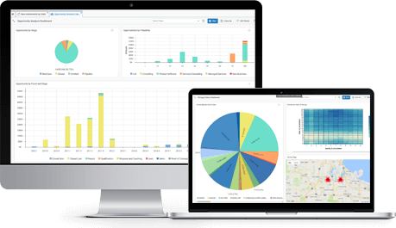


ARCHITECTURE
http://bdaipl.tech

Slide 4
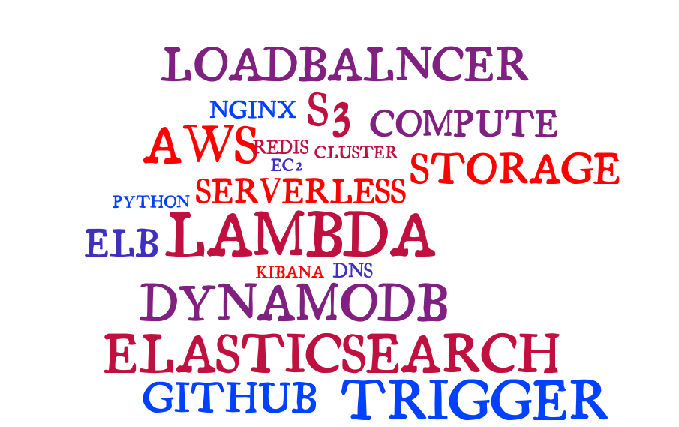
TECH STACK

Slide 5
ETL

Slide 6
EXTRACT
Data has been sourced from multiple areas
Scrapping popular cricketing websites
Scrapping wiki
Google API – Geo points
Kaggle competitions
All the data is further stored into S3.

Slide 7
Cont…
Raw data received in S3 is pushed into AWS DynamoDB.
S3 event invokes AWS Lambda which does the data parsing before it is rested in DynamoDB.
Three tables – Player, Matches, Deliveries
Data in DynamoDB acts a source of truth for all the further operations.

Slide 8
TRANSFORM
All the semi parsed data is transformed into a meaningful entity - JSON.
Triggers on DynamoDb would invoke AWS Lambda whenever a new entry is added into DynamoDb.
AWS Lambda transforms the data into a meaningful patterns, which are further loaded into elasticsearch cluster.
AWS Lambda would fetch additional geo data through Google API
AWS Lambda uses Redis for a quick key-value mapping lookup.

Slide 9
LOAD
Elasticsearch indexes all the incoming data from lambdas.
Data on elasticsearch is split on the nodes in the cluster.
All the three formats of the data are stored in different indices.
matches
players
deliveries

Slide 10
Two node cluster
Served out via Load Balancer
Load Balancer endpoint would be the face of the elasticsearch
Separate indices for all three types of data sources
Load Balancer
ES node-1
ES node-2

Slide 11
Face of the project
Dashboards are generated separately for each index.
Visualizations such as Geo Tagging, Heatmaps, Custom Metrics, Pie Charts, Bar Graphs
Filters applied on a visualization is applied across the dashboard

Slide 12
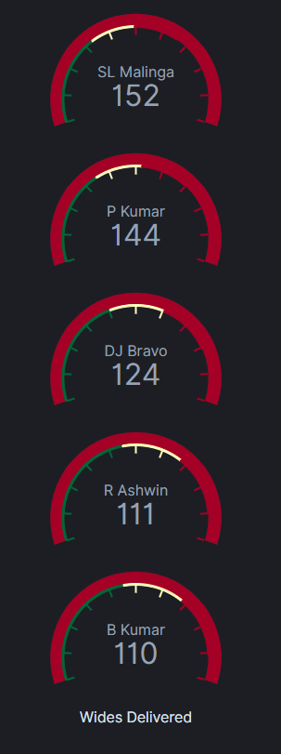
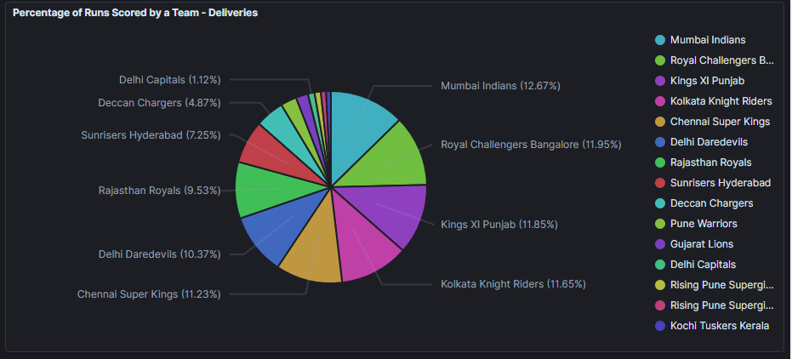
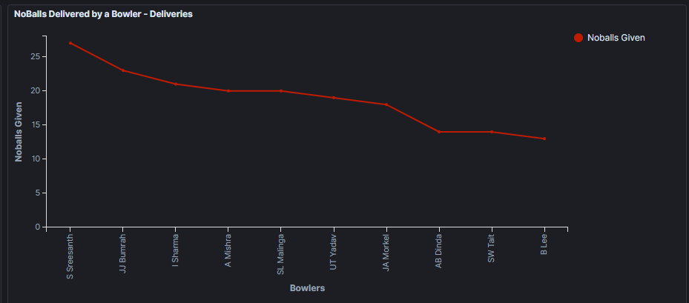
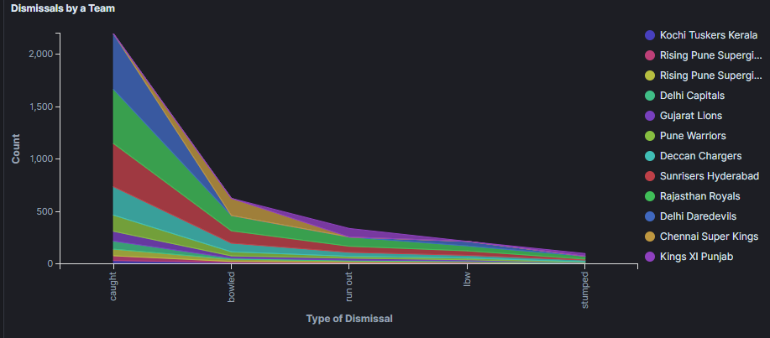
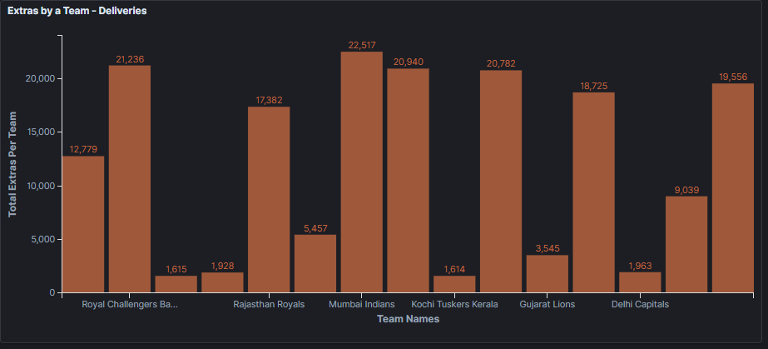
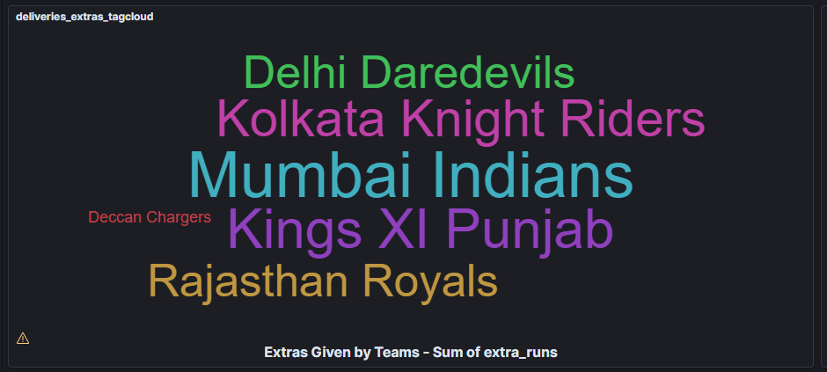
DELIVERIES DASHBOARD
http://bdaipl.tech/

Slide 13
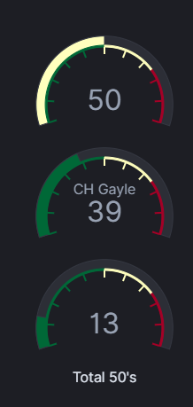
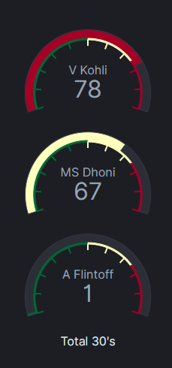
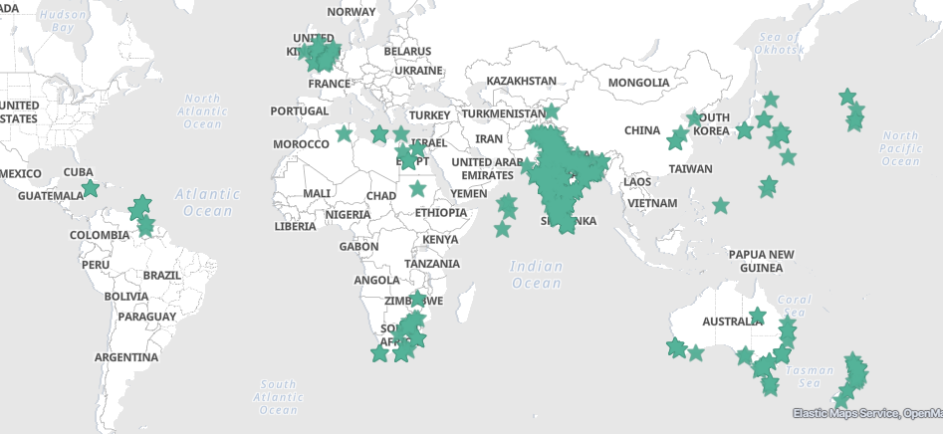
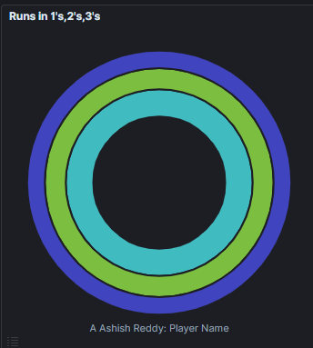
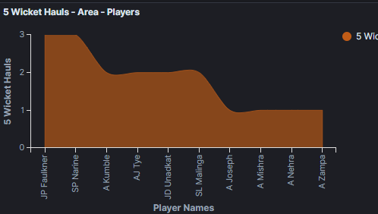
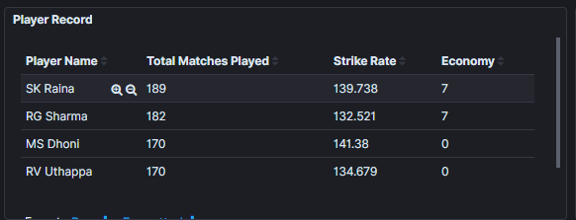
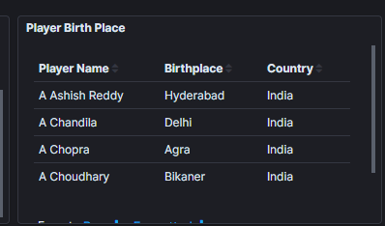
PLAYERS DASHBOARD

Slide 14
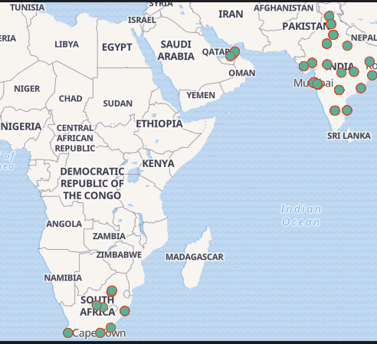
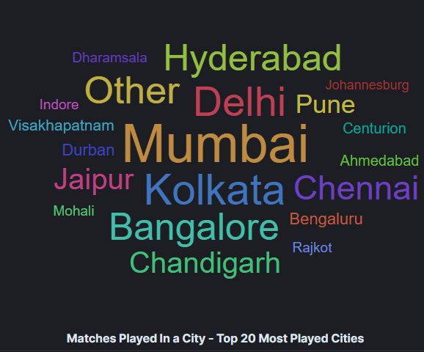
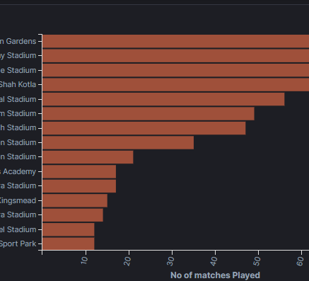
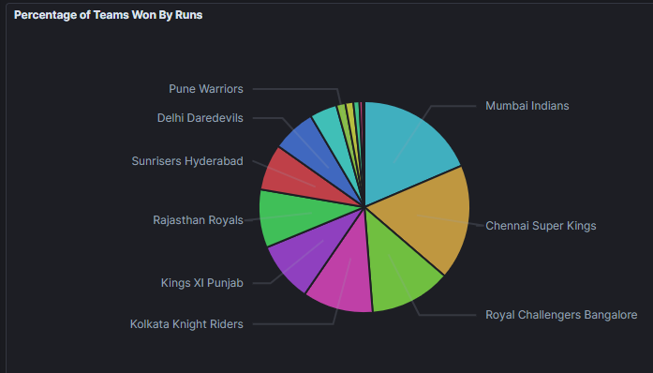
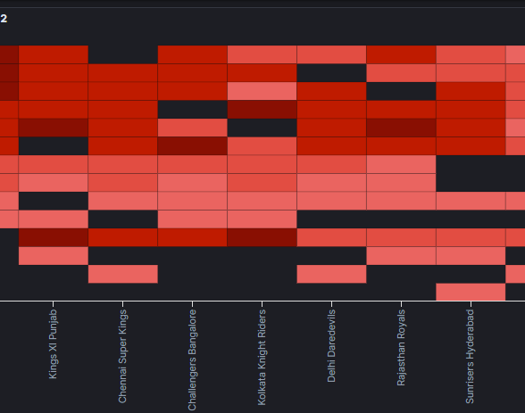
MATCHES DASHBOARD

Slide 15
Port Forwarding
Forwards request received on 80 to the Kibana’s listening port
Making Kibana as face of the application

Slide 16

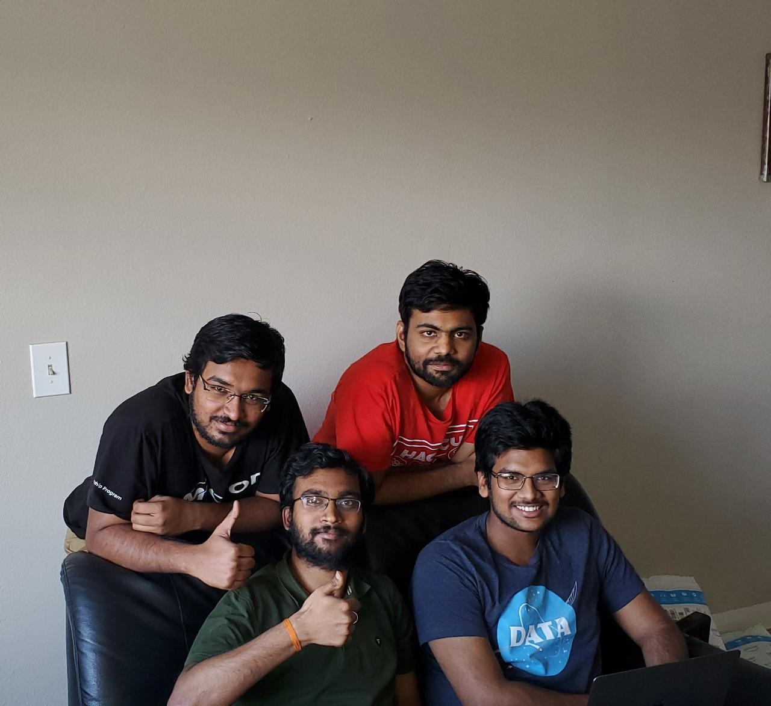
THANKS

